Slide 1

Data Science & Machine Learning Training Program
Notes:
AI-generated content may be incorrect. --- This training program provides a comprehensive overview of data science and machine learning, tailored for the Oil & Gas industry. We will cover foundational concepts, practical Python skills, web application development, ML models, and industry applications.

Slide 2
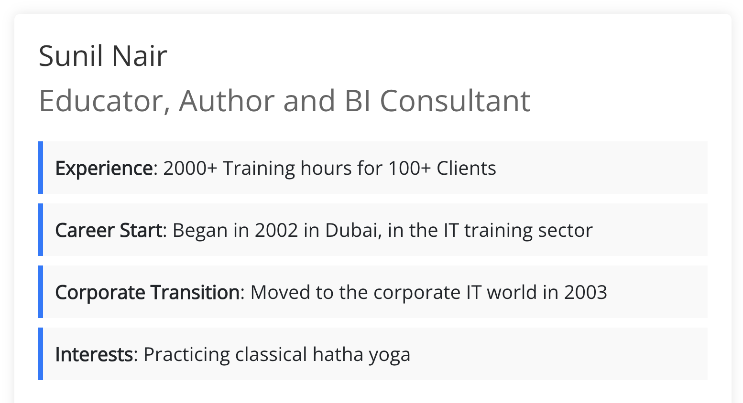

Slide 3

Agenda Overview
Introduction to Machine Learning, and Artificial Intelligence
Python Fundamentals for Data Science
Building Web Applications with Python Flask
Machine Learning Models
Industry Use Cases, and Wrap-Up
Notes:
--- Today’s program covers: an introduction to AI, machine learning, and emerging tools; Python fundamentals; building web applications with Flask; understanding machine learning models; and integration with real industry use cases and wrap-up. Image source: Microsoft 365 content library

Slide 4
Schedule
Schedule | Timings
Breakfast | 0800 to 0830
Session 1 | 0830 to 1015
Break 1 | 1015 to 1030
Session 2 | 1030 to 1215
Break 2 | 1215 to 1300
Session 3 | 1300 to 1430
Notes:
--- Today’s program covers: an introduction to AI, machine learning, and emerging tools; Python fundamentals; building web applications with Flask; understanding machine learning models; and integration with real industry use cases and wrap-up. Image source: Microsoft 365 content library

Slide 5
Introduction to AI, Machine Learning, and Emerging Tools
Notes:
--- This slide references information from the following file: https://trainingcopilot-my.sharepoint.com/personal/trainer9_train-copilot_com/_layouts/15/Doc.aspx?sourcedoc=%7B860907FA-1AAA-4456-8F54-FE8268BE49D3%7D&file=Data%20Science%20%26%20Machine%20Learning%20Training%20ProgramData%20Science%20%26%20Machine%20Learning%20Training%20Program.docx&action=default&mobileredirect=true&DefaultItemOpen=1 Program overview, objectives, and the role of AI/ML in Oil & Gas digital transformation, Core machine learning concepts and categories: supervised, unsupervised, and reinforcement learning, Deep learning essentials and NLP applications in Oil & Gas, Large Language Models, generative AI, risks, and responsible use, Applied tools and platforms: ChatGPT, Microsoft Copilot, Azure AI

Slide 6

Program overview, objectives, and the role of AI/ML in Oil & Gas digital transformation
Program Objectives and Structure
The program focuses on clear objectives and structured outcomes tailored for employees to enhance skills and knowledge.
Employee Outcomes
The program aims to equip employees with skills necessary for digital transformation in the oil and gas sector.
AI/ML Role in Transformation
AI and machine learning drive innovation and efficiency in oil and gas digital transformation initiatives.
Notes:
--- This slide references information from the following file: https://trainingcopilot-my.sharepoint.com/personal/trainer9_train-copilot_com/_layouts/15/Doc.aspx?sourcedoc=%7B860907FA-1AAA-4456-8F54-FE8268BE49D3%7D&file=Data%20Science%20%26%20Machine%20Learning%20Training%20ProgramData%20Science%20%26%20Machine%20Learning%20Training%20Program.docx&action=default&mobileredirect=true&DefaultItemOpen=1 · Program Overview o Objectives, structure, outcomes for ADNOC employees o Role of AI/ML in Oil & Gas digital transformation Image source: Microsoft 365 content library

Slide 7

Core machine learning concepts and categories: supervised, unsupervised, and reinforcement learning
Supervised Learning
Supervised learning involves predicting outcomes such as well productivity and equipment failures using labeled data.
Unsupervised Learning
Unsupervised learning focuses on clustering and anomaly detection in datasets like refinery data without labeled outcomes.
Reinforcement Learning
Reinforcement learning optimizes processes such as drilling and automates operations through reward-based learning.
Notes:
--- This slide references information from the following file: https://trainingcopilot-my.sharepoint.com/personal/trainer9_train-copilot_com/_layouts/15/Doc.aspx?sourcedoc=%7B860907FA-1AAA-4456-8F54-FE8268BE49D3%7D&file=Data%20Science%20%26%20Machine%20Learning%20Training%20ProgramData%20Science%20%26%20Machine%20Learning%20Training%20Program.docx&action=default&mobileredirect=true&DefaultItemOpen=1 · Machine Learning Concepts o What is ML? o Categories of ML: § Supervised Learning – predicting well productivity, equipment failures § Unsupervised Learning – clustering wells, anomaly detection in refinery data § Reinforcement Learning – drilling optimization, process automation Image source: Microsoft 365 content library

Slide 8

Deep learning essentials and NLP applications in Oil & Gas
Neural Networks Overview
Neural networks are computational models inspired by the human brain used in deep learning for pattern recognition and prediction.
NLP in Oil & Gas
Natural Language Processing analyzes maintenance logs and drilling reports to extract insights and improve operational efficiency.
Notes:
--- This slide references information from the following file: https://trainingcopilot-my.sharepoint.com/personal/trainer9_train-copilot_com/_layouts/15/Doc.aspx?sourcedoc=%7B860907FA-1AAA-4456-8F54-FE8268BE49D3%7D&file=Data%20Science%20%26%20Machine%20Learning%20Training%20ProgramData%20Science%20%26%20Machine%20Learning%20Training%20Program.docx&action=default&mobileredirect=true&DefaultItemOpen=1 · Deep Learning Essentials o Neural Networks explained o Natural Language Processing (NLP) – analyzing maintenance logs, drilling reports Image source: Microsoft 365 content library

Slide 9

Large Language Models, generative AI, risks, and responsible use
Large Language Models Overview
LLMs enable generative AI applications including text generation, code synthesis, and intelligent assistants.
Risks and Responsible Use
Understanding and mitigating risks in enterprise AI deployments ensures ethical and safe usage.
Prompt Engineering
Crafting effective prompts enhances AI response quality for safety, reporting, and technical queries.
Notes:
--- This slide references information from the following file: https://trainingcopilot-my.sharepoint.com/personal/trainer9_train-copilot_com/_layouts/15/Doc.aspx?sourcedoc=%7B860907FA-1AAA-4456-8F54-FE8268BE49D3%7D&file=Data%20Science%20%26%20Machine%20Learning%20Training%20ProgramData%20Science%20%26%20Machine%20Learning%20Training%20Program.docx&action=default&mobileredirect=true&DefaultItemOpen=1 · Large Language Models (LLMs) o Generative AI – text, code, knowledge assistants o Risks & responsible use in enterprise environments · Prompt Engineering o Crafting effective prompts for safety, reporting, and technical queries Image source: Microsoft 365 content library

Slide 10

Applied tools and platforms: ChatGPT, Microsoft Copilot, Azure AI
ChatGPT Capabilities
ChatGPT assists with document drafting, summarization, and extracting knowledge efficiently.
Microsoft Copilot Integration
Microsoft Copilot integrates AI seamlessly into productivity workflows to enhance user efficiency.
Azure AI Services
Azure AI provides vision, speech, language, and anomaly detection capabilities as cloud services.
Notes:
--- This slide references information from the following file: https://trainingcopilot-my.sharepoint.com/personal/trainer9_train-copilot_com/_layouts/15/Doc.aspx?sourcedoc=%7B860907FA-1AAA-4456-8F54-FE8268BE49D3%7D&file=Data%20Science%20%26%20Machine%20Learning%20Training%20ProgramData%20Science%20%26%20Machine%20Learning%20Training%20Program.docx&action=default&mobileredirect=true&DefaultItemOpen=1 · Applied Tools & Platforms o ChatGPT – document drafting, summarization, knowledge extraction o Microsoft Copilot – integration in productivity workflows o Azure AI – Vision, Speech, Language & Anomaly Detection services Image source: Microsoft 365 content library

Slide 11
Python Fundamentals for Data Science
Notes:
--- This slide references information from the following file: https://trainingcopilot-my.sharepoint.com/personal/trainer9_train-copilot_com/_layouts/15/Doc.aspx?sourcedoc=%7B860907FA-1AAA-4456-8F54-FE8268BE49D3%7D&file=Data%20Science%20%26%20Machine%20Learning%20Training%20ProgramData%20Science%20%26%20Machine%20Learning%20Training%20Program.docx&action=default&mobileredirect=true&DefaultItemOpen=1 Python basics refresher: syntax, variables, data types, control flow, and file handling, Key Python libraries for data science: NumPy, Pandas, Matplotlib/Seaborn, Hands-on exercises: loading, summarizing, and visualizing ADNOC-style data

Slide 12

Python basics refresher: syntax, variables, data types, control flow, and file handling
Python Syntax and Variables
Understanding Python syntax and declaring variables is essential for writing clear and effective code.
Core Data Types
Python supports key data types such as integers, floats, strings, lists, and dictionaries for versatile data handling.
Control Flow Structures
If statements, loops, and functions control the flow of execution and enable repetitive and dynamic tasks.
File Handling Basics
Reading and writing files in formats like CSV, JSON, and Excel is crucial for data processing tasks.
Notes:
--- This slide references information from the following file: https://trainingcopilot-my.sharepoint.com/personal/trainer9_train-copilot_com/_layouts/15/Doc.aspx?sourcedoc=%7B860907FA-1AAA-4456-8F54-FE8268BE49D3%7D&file=Data%20Science%20%26%20Machine%20Learning%20Training%20ProgramData%20Science%20%26%20Machine%20Learning%20Training%20Program.docx&action=default&mobileredirect=true&DefaultItemOpen=1 · Python Basics Refresher o Syntax, variables, data types (int, float, string, list, dict) o Control flow (if, loops, functions) o File handling basics (CSV, JSON, Excel) Image source: Microsoft 365 content library

Slide 13

Key Python libraries for data science: NumPy, Pandas, Matplotlib/Seaborn
NumPy Arrays and Math
NumPy provides efficient array structures and supports advanced mathematical operations for numerical computing.
Pandas DataFrames
Pandas enables data manipulation with DataFrames, including filtering, aggregation, and descriptive statistics.
Matplotlib and Seaborn Visualizations
Matplotlib and Seaborn libraries provide powerful tools for creating detailed and attractive data visualizations to explore data.
Notes:
--- This slide references information from the following file: https://trainingcopilot-my.sharepoint.com/personal/trainer9_train-copilot_com/_layouts/15/Doc.aspx?sourcedoc=%7B860907FA-1AAA-4456-8F54-FE8268BE49D3%7D&file=Data%20Science%20%26%20Machine%20Learning%20Training%20ProgramData%20Science%20%26%20Machine%20Learning%20Training%20Program.docx&action=default&mobileredirect=true&DefaultItemOpen=1 · Python Libraries for Data Science o NumPy – arrays, mathematical operations o Pandas – DataFrames, filtering, aggregation, descriptive stats o Matplotlib/Seaborn – visualization for data exploration Image source: Microsoft 365 content library

Slide 14

Hands-on exercises: loading, summarizing, and visualizing ADNOC-style data
Loading ADNOC-style Data
Load drilling or sensor data formatted in CSV files for further analysis and visualization.
Summary Statistics and Filtering
Perform summary statistics and filter data to extract meaningful insights from raw datasets.
Well Log Data Exploration
Explore well log data by visualizing depth versus porosity and resistivity trends for interpretation.
Notes:
--- This slide references information from the following file: https://trainingcopilot-my.sharepoint.com/personal/trainer9_train-copilot_com/_layouts/15/Doc.aspx?sourcedoc=%7B860907FA-1AAA-4456-8F54-FE8268BE49D3%7D&file=Data%20Science%20%26%20Machine%20Learning%20Training%20ProgramData%20Science%20%26%20Machine%20Learning%20Training%20Program.docx&action=default&mobileredirect=true&DefaultItemOpen=1 · Hands-On Exercises o Load ADNOC-style drilling or sensor data in CSV o Perform summary statistics, filtering, and visualization o Simple exploration of well log data (depth vs. porosity, resistivity trends) Image source: Microsoft 365 content library

Slide 15
Building Web Applications with Flask
Notes:
--- This slide references information from the following file: https://trainingcopilot-my.sharepoint.com/personal/trainer9_train-copilot_com/_layouts/15/Doc.aspx?sourcedoc=%7B860907FA-1AAA-4456-8F54-FE8268BE49D3%7D&file=Data%20Science%20%26%20Machine%20Learning%20Training%20ProgramData%20Science%20%26%20Machine%20Learning%20Training%20Program.docx&action=default&mobileredirect=true&DefaultItemOpen=1 Introduction to Flask and project structure, Creating a basic web app: routes, templates, and Jinja2 rendering, Connecting Flask with data science: dataset uploads, running scripts, and displaying results, Hands-on exercises: building apps for Oil & Gas data and visualizing drilling trends

Slide 16
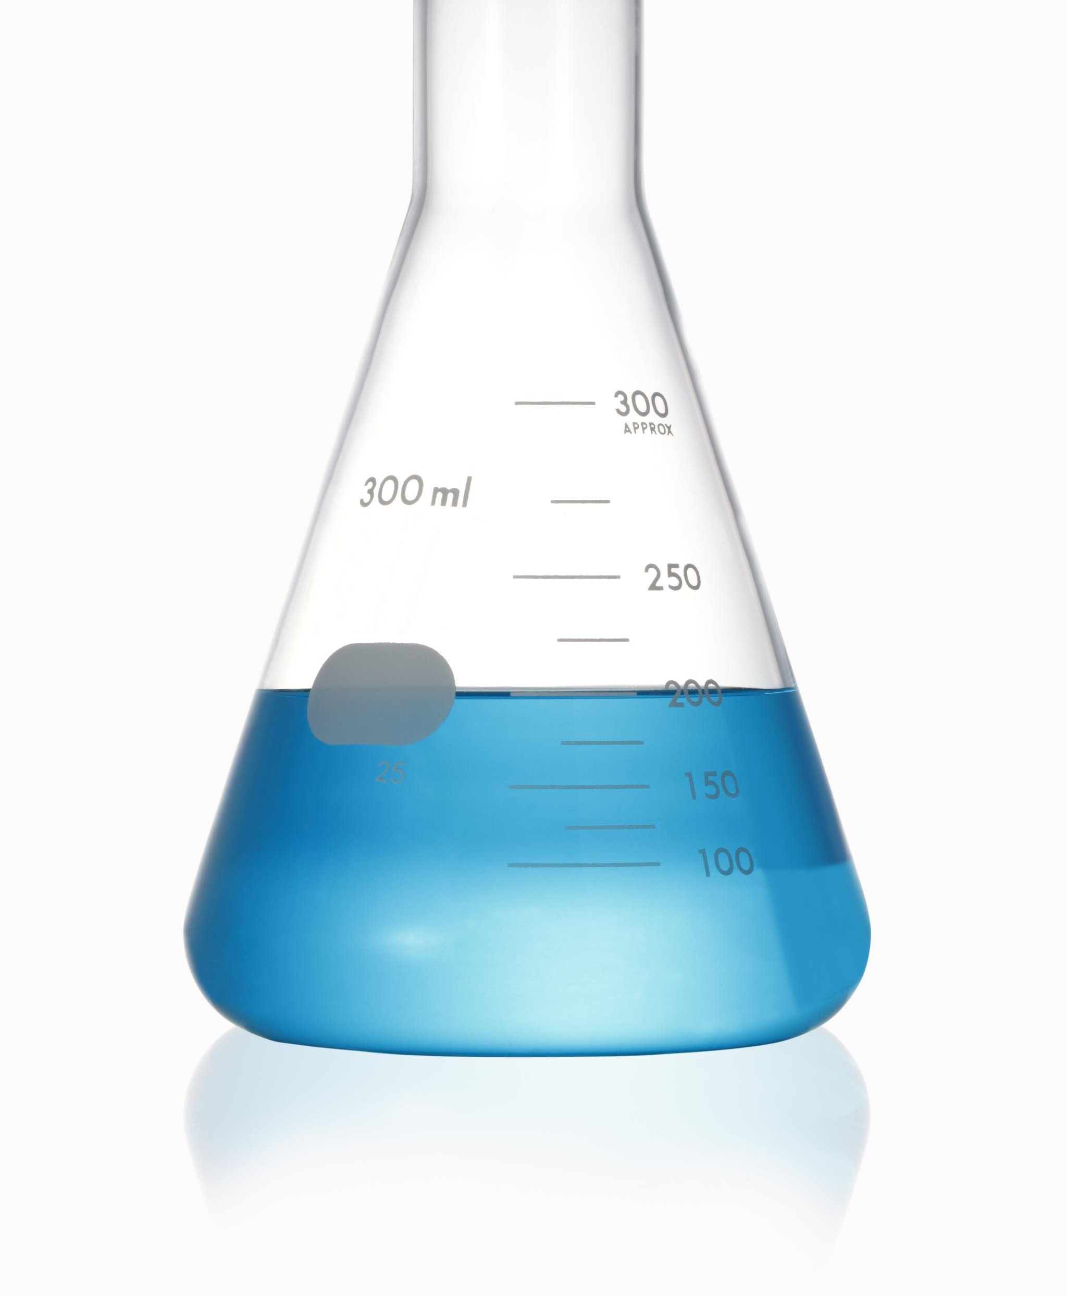
Introduction to Flask and project structure
What is Flask
Flask is a lightweight Python web framework used to build data-driven applications efficiently.
Importance for Data Apps
Flask enables rapid development and flexibility for building data-driven web applications.
Flask Project Structure
Key components include routes, templates, and static files organizing the web application's functionality and appearance.
Notes:
--- This slide references information from the following file: https://trainingcopilot-my.sharepoint.com/personal/trainer9_train-copilot_com/_layouts/15/Doc.aspx?sourcedoc=%7B860907FA-1AAA-4456-8F54-FE8268BE49D3%7D&file=Data%20Science%20%26%20Machine%20Learning%20Training%20ProgramData%20Science%20%26%20Machine%20Learning%20Training%20Program.docx&action=default&mobileredirect=true&DefaultItemOpen=1 · Introduction to Flask o What is Flask? Why it matters for data-driven apps o Flask project structure (routes, templates, static files) Image source: Microsoft 365 content library

Slide 17

Creating a basic web app: routes, templates, and Jinja2 rendering
Building Basic Web App
Create a simple web app that displays a greeting message to users.
Adding Routes
Define URL routes to connect web pages with backend functions for dynamic content.
Using Jinja2 Templates
Render dynamic HTML pages by combining templates with data using Jinja2.
Notes:
--- This slide references information from the following file: https://trainingcopilot-my.sharepoint.com/personal/trainer9_train-copilot_com/_layouts/15/Doc.aspx?sourcedoc=%7B860907FA-1AAA-4456-8F54-FE8268BE49D3%7D&file=Data%20Science%20%26%20Machine%20Learning%20Training%20ProgramData%20Science%20%26%20Machine%20Learning%20Training%20Program.docx&action=default&mobileredirect=true&DefaultItemOpen=1 · Creating a Basic Web App o Building a simple “Hello ADNOC” app o Adding routes and rendering templates with Jinja2 Image source: Microsoft 365 content library

Slide 18

Connecting Flask with data science: dataset uploads, running scripts, and displaying results
Dataset Uploads
Enable users to upload datasets directly through a user-friendly web interface in Flask applications.
Running Python Scripts
Execute Python data science scripts seamlessly within Flask routes to process uploaded data dynamically.
Displaying Results
Show processed data and analysis results interactively on web pages for user consumption.
Notes:
--- This slide references information from the following file: https://trainingcopilot-my.sharepoint.com/personal/trainer9_train-copilot_com/_layouts/15/Doc.aspx?sourcedoc=%7B860907FA-1AAA-4456-8F54-FE8268BE49D3%7D&file=Data%20Science%20%26%20Machine%20Learning%20Training%20ProgramData%20Science%20%26%20Machine%20Learning%20Training%20Program.docx&action=default&mobileredirect=true&DefaultItemOpen=1 · Connecting Flask with Data Science o Uploading datasets through the web interface o Running Python scripts inside Flask routes o Displaying processed results on a webpage Image source: Microsoft 365 content library

Slide 19
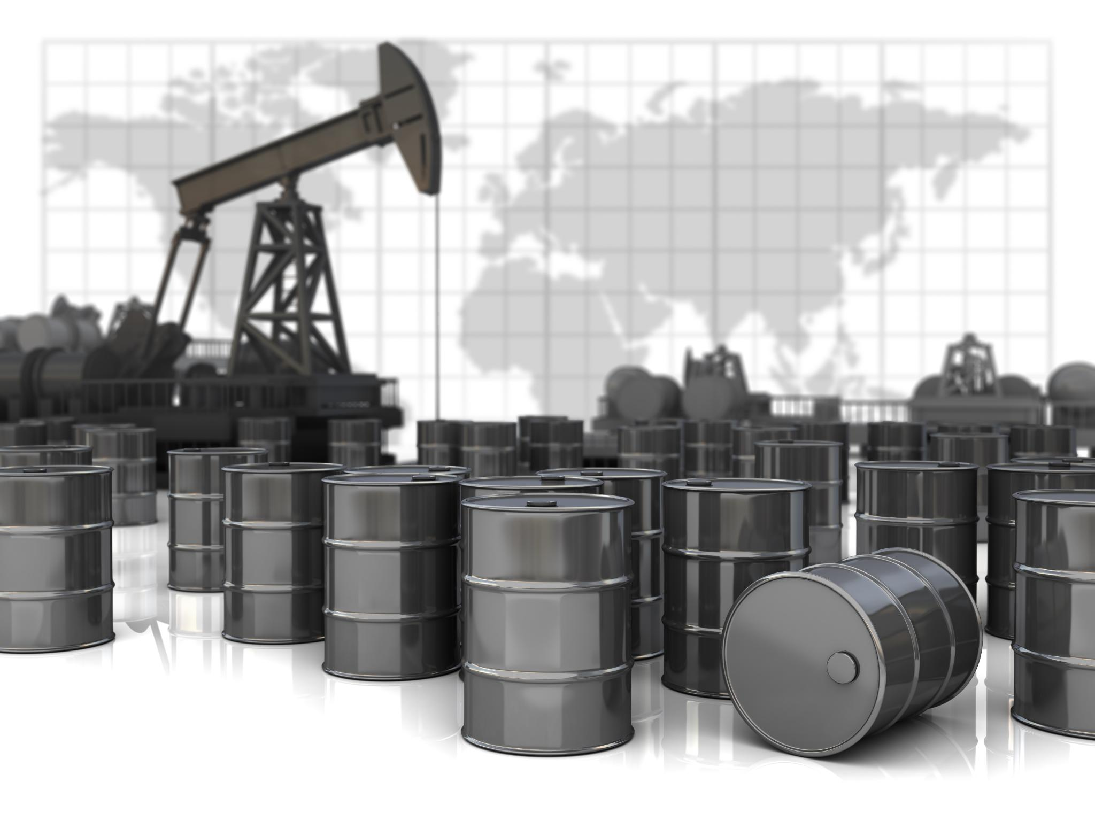
Hands-on exercises: building apps for Oil & Gas data and visualizing drilling trends
Flask App Development
Build a Flask web app that processes Oil & Gas CSV data and generates summary statistics dynamically.
Data Visualization
Visualize drilling parameter trends using charts embedded directly within the web application for easy analysis.
Notes:
--- This slide references information from the following file: https://trainingcopilot-my.sharepoint.com/personal/trainer9_train-copilot_com/_layouts/15/Doc.aspx?sourcedoc=%7B860907FA-1AAA-4456-8F54-FE8268BE49D3%7D&file=Data%20Science%20%26%20Machine%20Learning%20Training%20ProgramData%20Science%20%26%20Machine%20Learning%20Training%20Program.docx&action=default&mobileredirect=true&DefaultItemOpen=1 · Hands-On Exercises o Build a Flask app that accepts Oil & Gas data (CSV) and shows summary statistics o Visualize drilling parameter trends (charts) directly on the web app Image source: Microsoft 365 content library

Slide 20
Machine Learning Models
Notes:
--- This slide references information from the following file: https://trainingcopilot-my.sharepoint.com/personal/trainer9_train-copilot_com/_layouts/15/Doc.aspx?sourcedoc=%7B860907FA-1AAA-4456-8F54-FE8268BE49D3%7D&file=Data%20Science%20%26%20Machine%20Learning%20Training%20ProgramData%20Science%20%26%20Machine%20Learning%20Training%20Program.docx&action=default&mobileredirect=true&DefaultItemOpen=1 Supervised learning: regression, classification, and model evaluation, Unsupervised learning: clustering and dimensionality reduction, Neural networks: structure, working, and Oil & Gas applications, Hands-on exercises: regression, classification, and clustering for Oil & Gas use cases

Slide 21

Supervised learning: regression, classification, and model evaluation
Regression Prediction
Regression predicts continuous outcomes like oil production using well characteristics.
Classification Tasks
Classification predicts categories such as safety incidents and drilling operation types.
Model Evaluation Metrics
Model performance is evaluated using R², RMSE, accuracy, precision, recall, and F1-score.
Notes:
--- This slide references information from the following file: https://trainingcopilot-my.sharepoint.com/personal/trainer9_train-copilot_com/_layouts/15/Doc.aspx?sourcedoc=%7B860907FA-1AAA-4456-8F54-FE8268BE49D3%7D&file=Data%20Science%20%26%20Machine%20Learning%20Training%20ProgramData%20Science%20%26%20Machine%20Learning%20Training%20Program.docx&action=default&mobileredirect=true&DefaultItemOpen=1 · Supervised Learning o Regression: predicting oil production using well characteristics o Classification: safety incident prediction, drilling operation categorization o Model evaluation: R², RMSE, Accuracy, Precision, Recall, F1-score Image source: Microsoft 365 content library

Slide 22
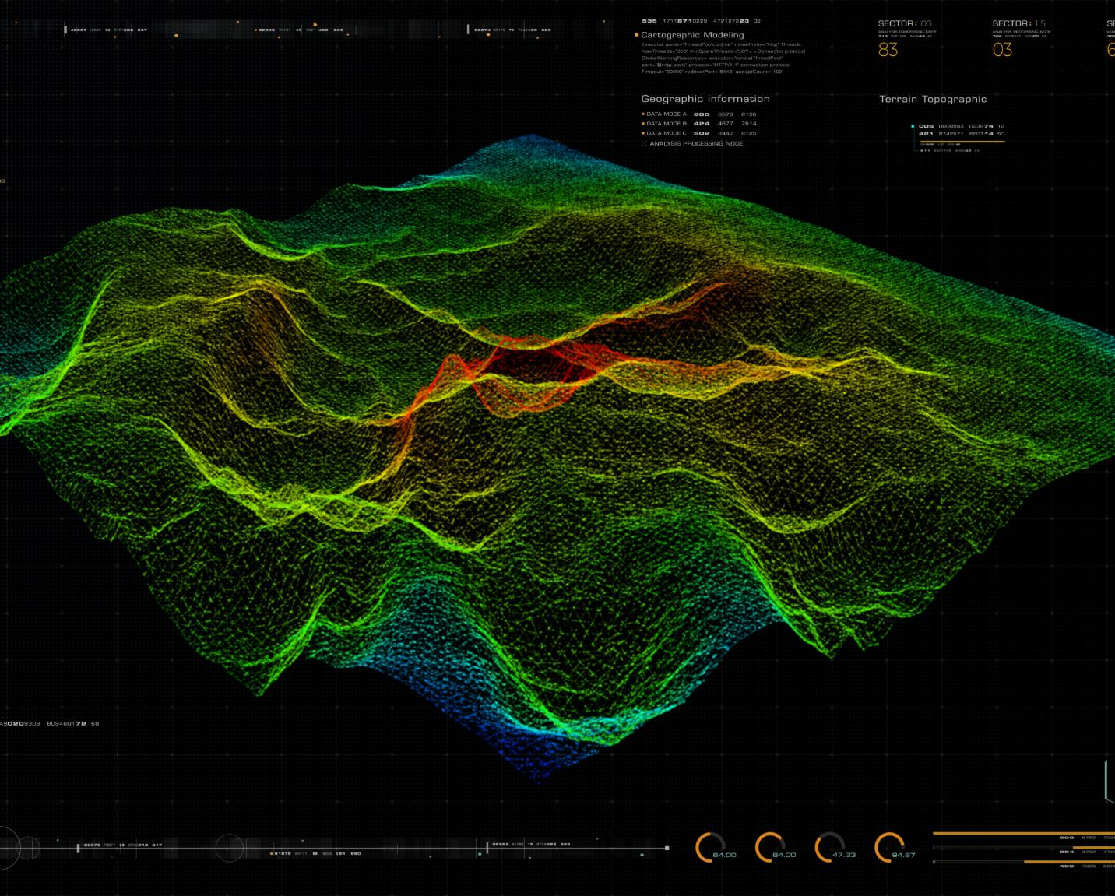
Unsupervised learning: clustering and dimensionality reduction
Clustering for Well Classification
Clustering groups wells based on productivity or geological characteristics for better resource management.
Dimensionality Reduction with PCA
Principal Component Analysis simplifies seismic datasets by reducing data dimensions while preserving key information.
Notes:
--- This slide references information from the following file: https://trainingcopilot-my.sharepoint.com/personal/trainer9_train-copilot_com/_layouts/15/Doc.aspx?sourcedoc=%7B860907FA-1AAA-4456-8F54-FE8268BE49D3%7D&file=Data%20Science%20%26%20Machine%20Learning%20Training%20ProgramData%20Science%20%26%20Machine%20Learning%20Training%20Program.docx&action=default&mobileredirect=true&DefaultItemOpen=1 · Unsupervised Learning o Clustering wells by productivity or geological similarity o Dimensionality reduction: PCA for seismic dataset simplification Image source: Microsoft 365 content library

Slide 23

Neural networks: structure, working, and Oil & Gas applications
Feedforward Neural Network Structure
A simple feedforward neural network consists of input, hidden, and output layers that process data sequentially.
Seismic Image Interpretation
Neural networks analyze seismic images to identify geological features critical for oil and gas exploration.
Pipeline Defect Detection
Neural networks detect defects in pipelines by analyzing sensor data to ensure safety and maintenance.
Notes:
--- This slide references information from the following file: https://trainingcopilot-my.sharepoint.com/personal/trainer9_train-copilot_com/_layouts/15/Doc.aspx?sourcedoc=%7B860907FA-1AAA-4456-8F54-FE8268BE49D3%7D&file=Data%20Science%20%26%20Machine%20Learning%20Training%20ProgramData%20Science%20%26%20Machine%20Learning%20Training%20Program.docx&action=default&mobileredirect=true&DefaultItemOpen=1 · Neural Networks o Structure and working of a simple feedforward network o Oil & Gas applications: seismic image interpretation, pipeline defect detection Image source: Microsoft 365 content library

Slide 24
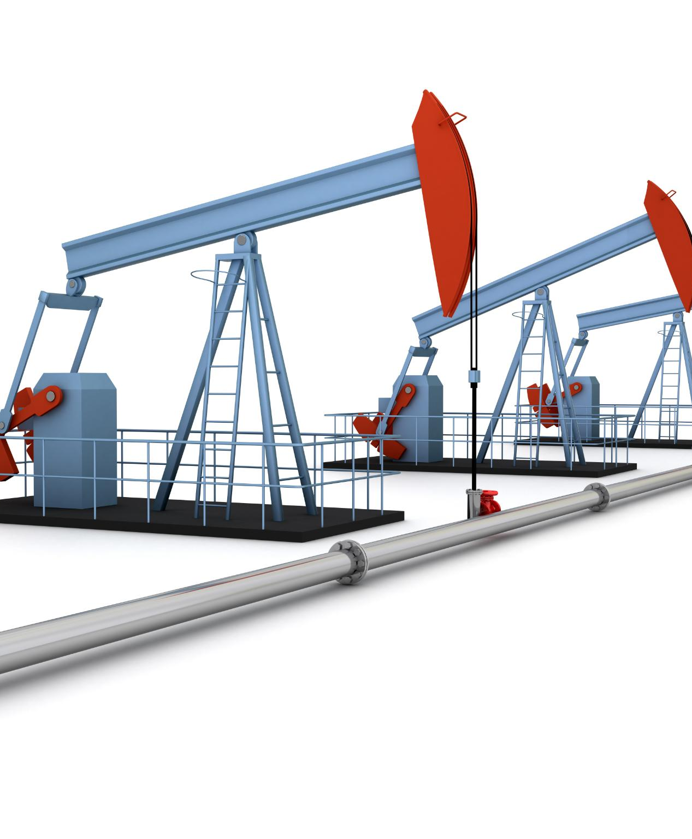
Hands-on exercises: regression, classification, and clustering for Oil & Gas use cases
Regression for Production Forecasting
Build regression models to accurately forecast oil and gas production over time.
Classification for Equipment Failure
Use classification techniques to predict potential equipment failures and prevent downtime.
Clustering for Customer Segmentation
Apply clustering algorithms to segment fuel station customers by demand patterns.
Notes:
--- This slide references information from the following file: https://trainingcopilot-my.sharepoint.com/personal/trainer9_train-copilot_com/_layouts/15/Doc.aspx?sourcedoc=%7B860907FA-1AAA-4456-8F54-FE8268BE49D3%7D&file=Data%20Science%20%26%20Machine%20Learning%20Training%20ProgramData%20Science%20%26%20Machine%20Learning%20Training%20Program.docx&action=default&mobileredirect=true&DefaultItemOpen=1 · Hands-On Exercises o Build a regression model for production forecasting o Use classification to predict equipment failure o Apply clustering for customer segmentation of fuel station demand Image source: Microsoft 365 content library

Slide 25
Integration, Industry Use Cases, and Wrap-Up
Notes:
--- This slide references information from the following file: https://trainingcopilot-my.sharepoint.com/personal/trainer9_train-copilot_com/_layouts/15/Doc.aspx?sourcedoc=%7B860907FA-1AAA-4456-8F54-FE8268BE49D3%7D&file=Data%20Science%20%26%20Machine%20Learning%20Training%20ProgramData%20Science%20%26%20Machine%20Learning%20Training%20Program.docx&action=default&mobileredirect=true&DefaultItemOpen=1 End-to-end workflow: data preprocessing, ML modeling, and deployment in Flask, Oil & Gas industry use cases: predictive maintenance, anomaly detection, demand forecasting, Wrap-up and discussion: key learnings, next steps, and future technologies

Slide 26

End-to-end workflow: data preprocessing, ML modeling, and deployment in Flask
Data Preprocessing
Raw data is cleaned and transformed to prepare for machine learning modeling.
Machine Learning Modeling
A machine learning model is developed to predict maintenance needs from processed data.
Deployment in Flask
The ML model is deployed using Flask to create a predictive maintenance web application.
Notes:
--- This slide references information from the following file: https://trainingcopilot-my.sharepoint.com/personal/trainer9_train-copilot_com/_layouts/15/Doc.aspx?sourcedoc=%7B860907FA-1AAA-4456-8F54-FE8268BE49D3%7D&file=Data%20Science%20%26%20Machine%20Learning%20Training%20ProgramData%20Science%20%26%20Machine%20Learning%20Training%20Program.docx&action=default&mobileredirect=true&DefaultItemOpen=1 · End-to-End Workflow o From raw data → preprocessing → ML model → deployment in Flask o Demonstrating a “Predictive Maintenance Web App” concept Image source: Microsoft 365 content library

Slide 27
Oil & Gas industry use cases: predictive maintenance, anomaly detection, demand forecasting
Predictive Maintenance
Predictive maintenance helps monitor drilling rigs to prevent unexpected failures and reduce downtime.
Anomaly Detection
Detecting anomalies in refinery operations improves safety and operational efficiency by identifying irregularities early.
Demand Forecasting
Demand forecasting for fuel stations ensures better inventory management and meets consumer needs effectively.
Notes:
--- This slide references information from the following file: https://trainingcopilot-my.sharepoint.com/personal/trainer9_train-copilot_com/_layouts/15/Doc.aspx?sourcedoc=%7B860907FA-1AAA-4456-8F54-FE8268BE49D3%7D&file=Data%20Science%20%26%20Machine%20Learning%20Training%20ProgramData%20Science%20%26%20Machine%20Learning%20Training%20Program.docx&action=default&mobileredirect=true&DefaultItemOpen=1 · Oil & Gas Industry Use Cases o Predictive maintenance on drilling rigs o Anomaly detection in refinery operations o Demand forecasting for downstream fuel stations Image source: Microsoft 365 content library

Slide 28

Wrap-up and discussion: key learnings, next steps, and future technologies
Key Learnings Summary
Summarize the essential takeaways and insights gained from the AI implementation and discussions.
Next Steps for AI Scaling
Outline actionable steps to expand and scale AI technologies within ADNOC's operations effectively.
Future Technology Trends
Explore emerging technologies like AI integrated with IoT, Digital Twins, and Generative AI for technical documentation.
Notes:
--- This slide references information from the following file: https://trainingcopilot-my.sharepoint.com/personal/trainer9_train-copilot_com/_layouts/15/Doc.aspx?sourcedoc=%7B860907FA-1AAA-4456-8F54-FE8268BE49D3%7D&file=Data%20Science%20%26%20Machine%20Learning%20Training%20ProgramData%20Science%20%26%20Machine%20Learning%20Training%20Program.docx&action=default&mobileredirect=true&DefaultItemOpen=1 · Wrap-Up & Discussion o Key learnings o Next steps for scaling AI within ADNOC o Future technologies (AI + IoT, Digital Twins, Generative AI for technical documentation) Image source: Microsoft 365 content library

Slide 29
Conclusion
Comprehensive Training Overview
The program covers data science, machine learning, Python programming, and web app development comprehensively.
Industry-Specific Applications
Focus on applying learned skills specifically to the Oil & Gas industry enhances practical relevance.
Empowering Future Learning
Participants are encouraged to continue learning and apply skills to real-world challenges effectively.
Notes:
This training program has provided a solid foundation in data science and machine learning concepts, Python programming, web app development, and industry-specific applications for Oil & Gas. We hope participants are equipped to apply these skills in real-world scenarios and continue their learning journey.

